Slide 1
IST 722 Group 3
Fudgemart, Inc.

Slide 2
Agenda
01 | Introduction & Project Goals
02 | Merged Star Schema & Key Assumptions
03 | Data Population Summary (Row Counts)
04 | Analysis Measures (Merged + Company + Category)
05 | Data Warehouse Overview & Design
06 | ETL & dbt Challenges
07 | BI Insights / Power BI Story
08 | Recommendations & Next Step

Slide 3
Introduction
Introduction & Project Goals
Introduction & Project Goals
Fudgemart Inc. is a conglomerate that has merged Fudgemart (online retailer) and Fudgeflix (video on demand) into one company. Our goal is to combine the databases of the two companies and report them to our external customers as a single company.

Slide 4
Project Goals
Introduction & Project Goals
Introduction & Project Goals
Integrate data from Fudgemart and FudgeFlix databases
Implement dimensional models
Build a Snowflake data warehouse
Implement ELT pipelines using DBT
Produce PowerBI dashboard for analytics
Provide a unified view of Fudgemart and Fudgeflix performance
Provide insights into sales and product performance

Slide 5
Project ROLES
Nicolas Sommer – Project Manager & Data Warehouse Engineer
Nat Roberts– Data Modeler (Dimensional Modeling Specialist)
Unur Gantulga– Data Engineer (ETL & Data Validation)
Michael Cardosa– Business Intelligence Developer

Slide 6
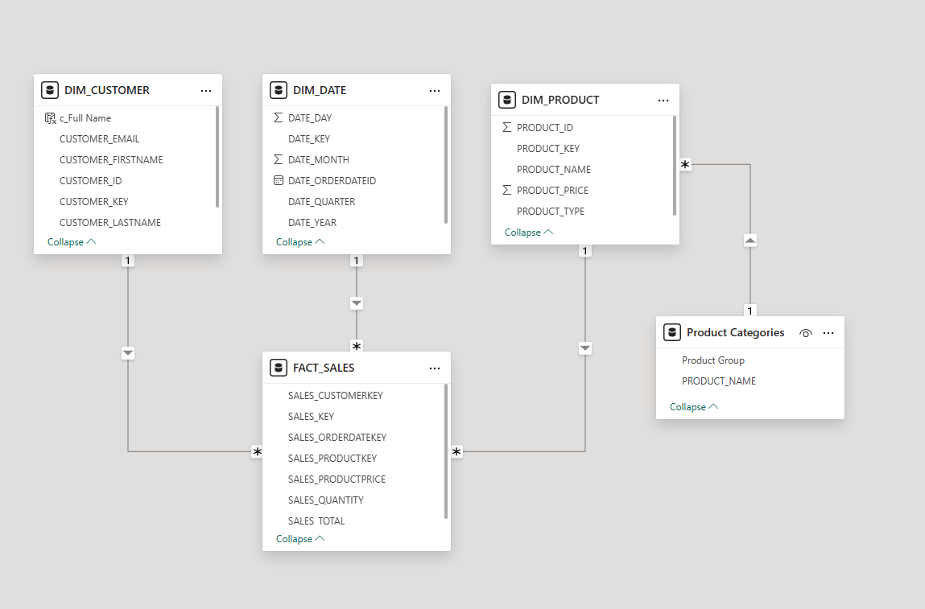
STAR SCHEMA

Slide 7
Data Population Summary (Row Counts)
Fudgemart
fm_customers
Rows = 25
fm_products
Rows = 53
fm_orders
Rows = 3,516
fm_order_details
Rows = 10,466
Fudgeflix
ff_accounts
Rows = 35
ff_plans
Rows = 7
ff_account_billing
Rows = 1,294

Slide 8
Key Assumptions in Merged Data
All customers = ff_Accounts + fm_Customers
Subscription = Product

Slide 9
Analysis Measures (MERGED + Product + Category)
Fudgemart, Inc. Sales
Granularity: One row = one product per order
Merged data allows us to look at Fudgemart orders and Fudgeflix transactions together
Data available to observe transactions, order details, subscription types, and customer profiles
Facts of interest
Sales totals & quantity per product in order
Sales totals & quantity by product category
Sales trends across time

Slide 10
DATA WAREHOUSE overview
Data Sources
Fudgemart (retail transactions)
Fudgeflix (subscription & streaming data)
Data Integration
Extracted data from Azure SQL source systems
Loaded data into Snowflake staging tables
Data Modeling
Transformed data into a star schema
Created dimension tables (dim_customer, dim_product, dim_date)
Built FACT_SALES as the central fact table
Data Validation
Verified row counts and joins
Ensured consistency across sources
Fudgemart + Fudgeflix → Azure SQL → Snowflake (Staging) → Star Schema → Analytics / BI

Slide 11
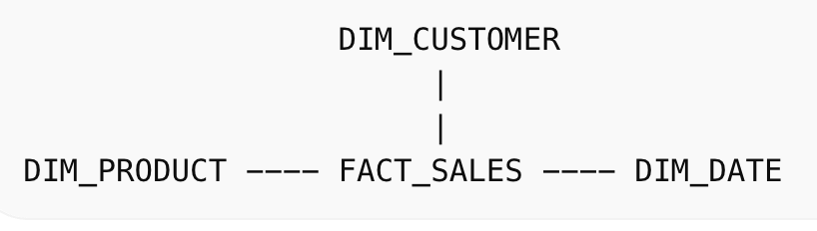
DATA WAREHOUSE DESIGN
FACT_SALES
Stores transaction-level sales data
Measures: quantity, total sales, product price
Links to customer, product, and date dimensions
DIM_CUSTOMER
Contains customer attributes
Integrates customers from both Fudgemart and Fudgeflix
DIM_PRODUCT
Contains product and subscription plan details
Supports analysis across different product types
DIM_date
Enables time-based analysis
Includes year, month, quarter and day breakdown

Slide 12
Our dbt Workflow: Process Overview
Introduction & Project Goals
Introduction & Project Goals
Setting up the project structure
Creating staging, dimension, and fact layers following a clean folder and naming convention.
Building staging models
Selecting and renaming columns, applying light transformations, and preparing clean inputs for downstream models.
Creating dimension and fact models
Referencing staging models with ref(), applying business logic, and ensuring relationships aligned with the star schema.
Validating lineage and consistency
Checking model dependencies, reviewing dbt docs, and confirming naming and assumptions stayed aligned.

Slide 13
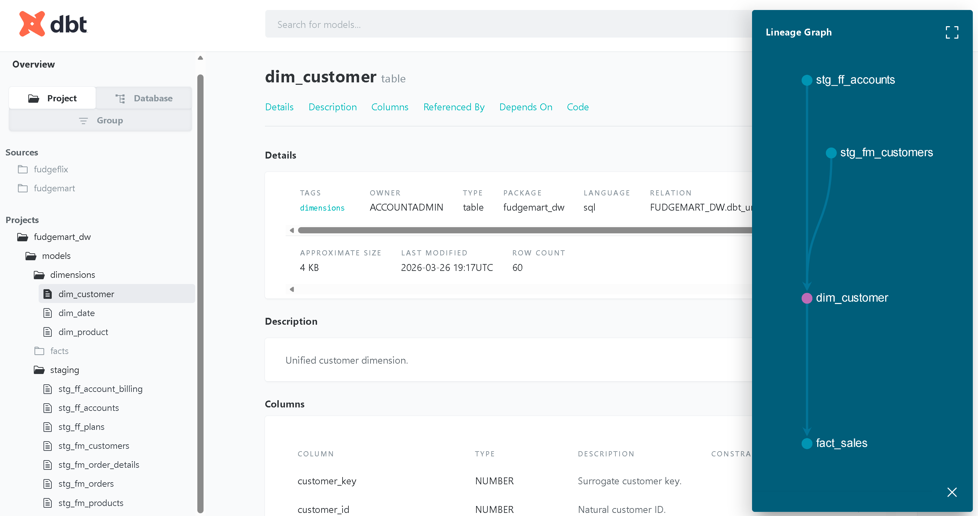
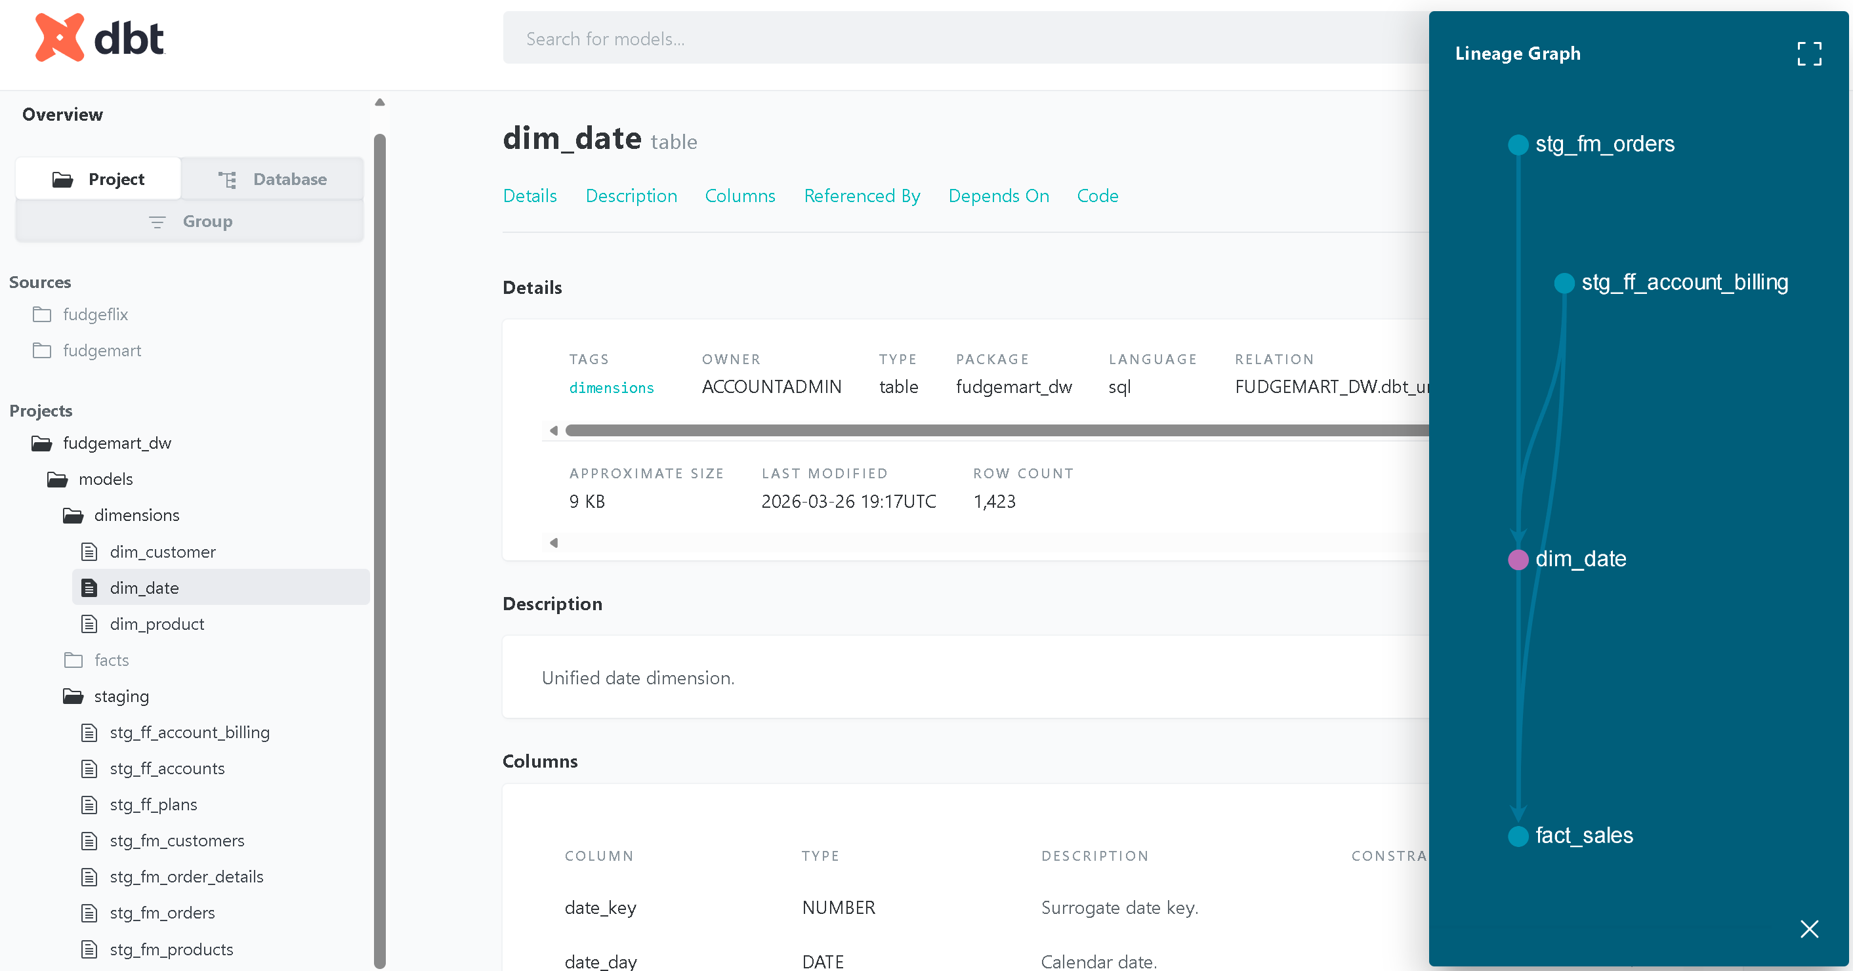

ETL & DATA VALIDATION
Dim_customer
Dim_date
Dim_product

Slide 14
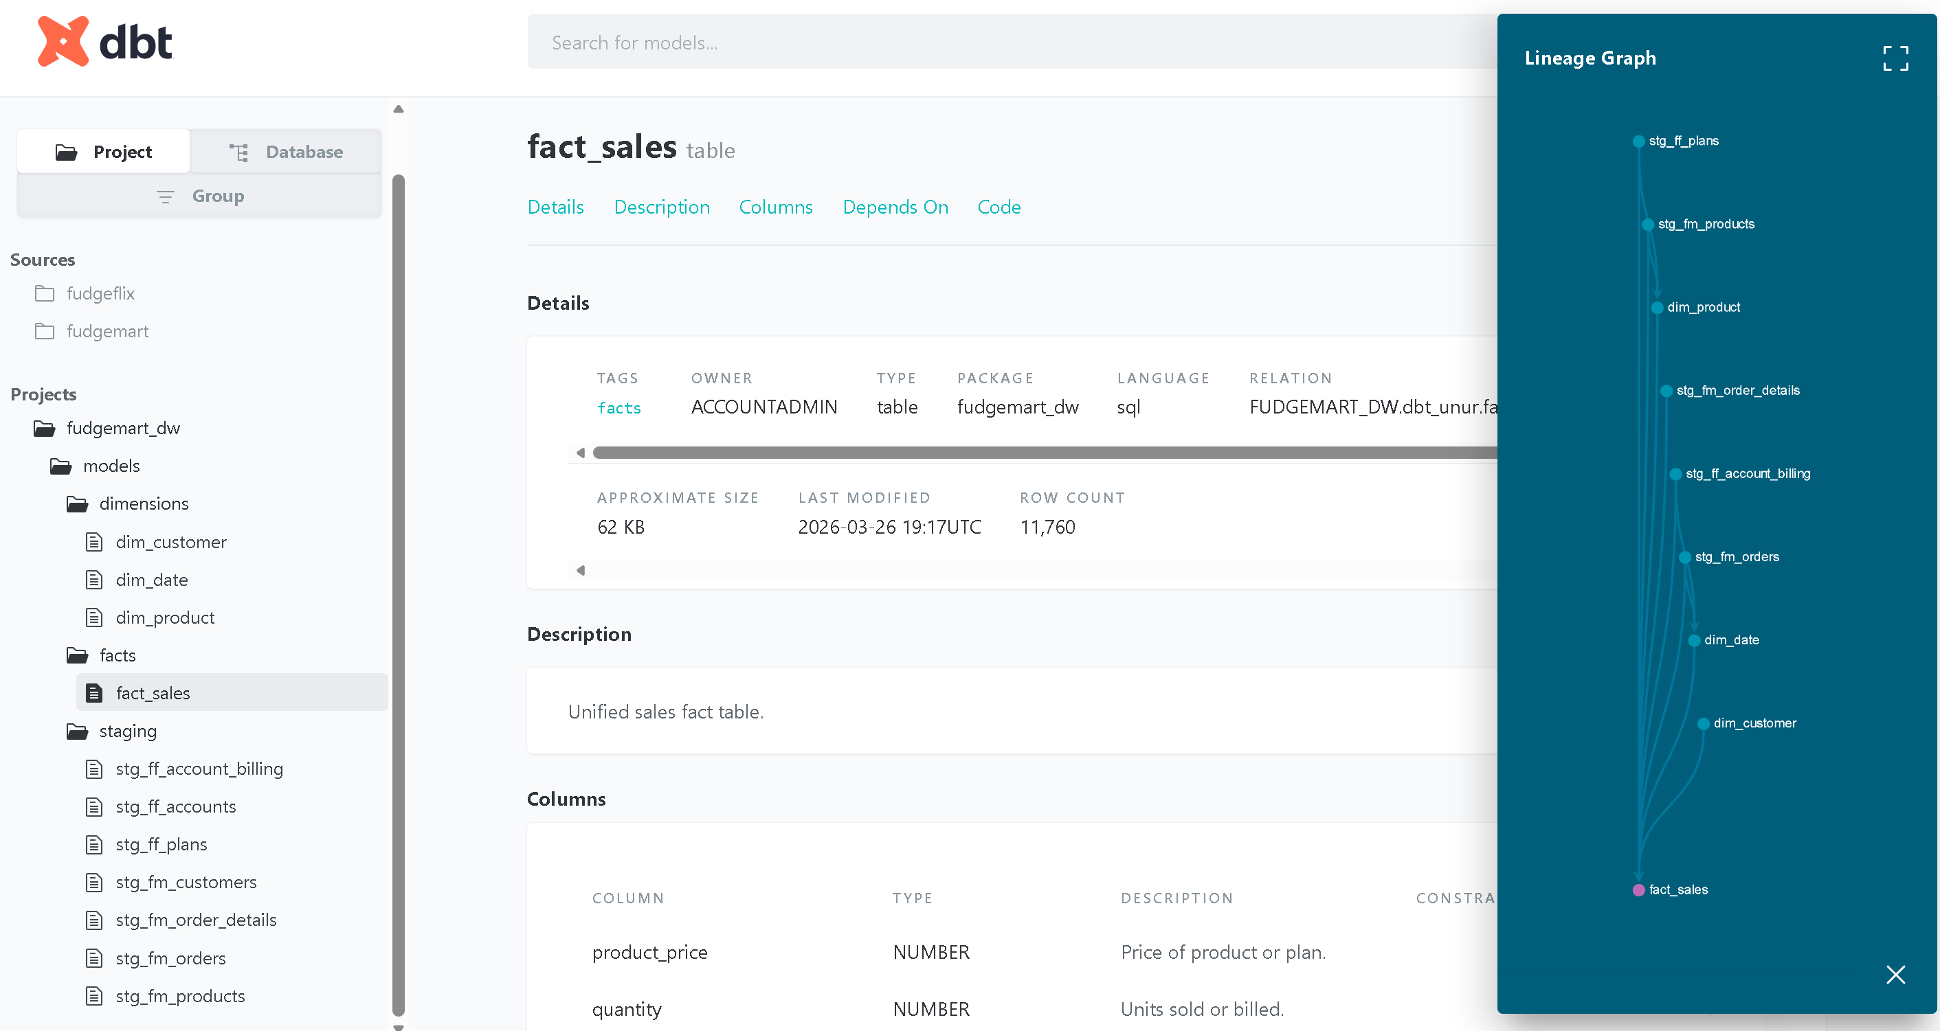
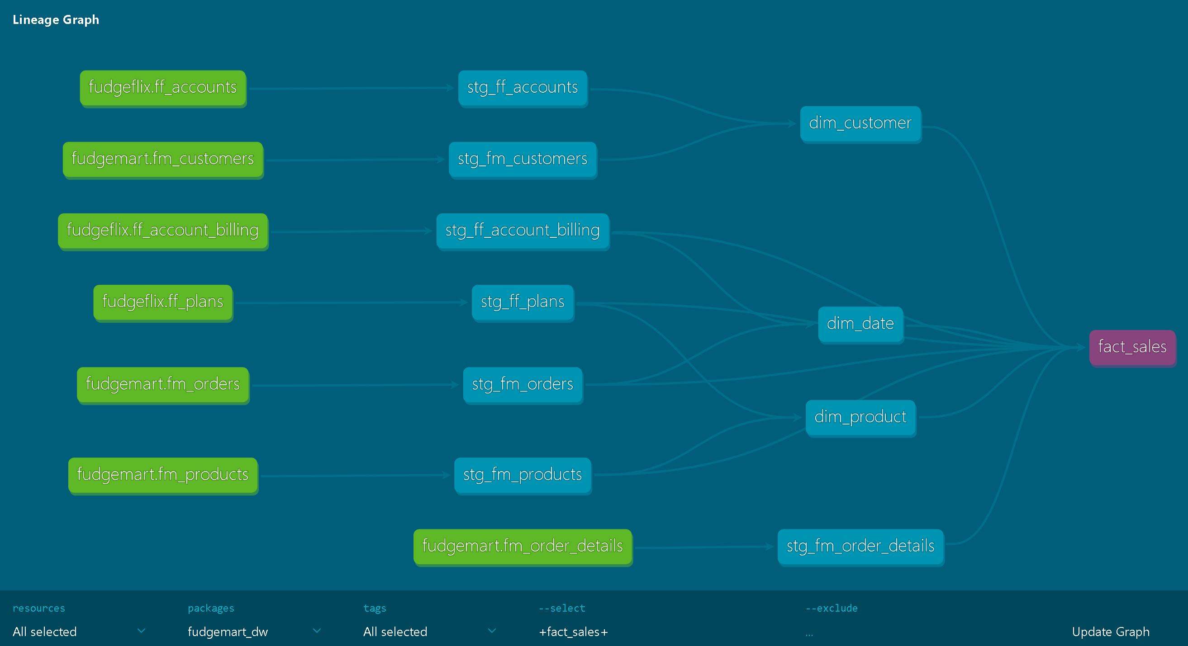
ETL & DATA VALIDATION
FACT_SALES
FULL MODEL LINEAGE

Slide 15
ETL & dbt Considerations
Aligning naming, structure, and assumptions across two companies
Coordinating model dependencies
Keeping staging models consistent
Ensuring staging → dimensions → fact models were referenced correctly so dbt built in the right order.
Aligning structure, naming, and column selection across all staging models for clarity and maintainability.
Ensuring naming conventions and assumptions stayed consistent across models as we built them.

Slide 16
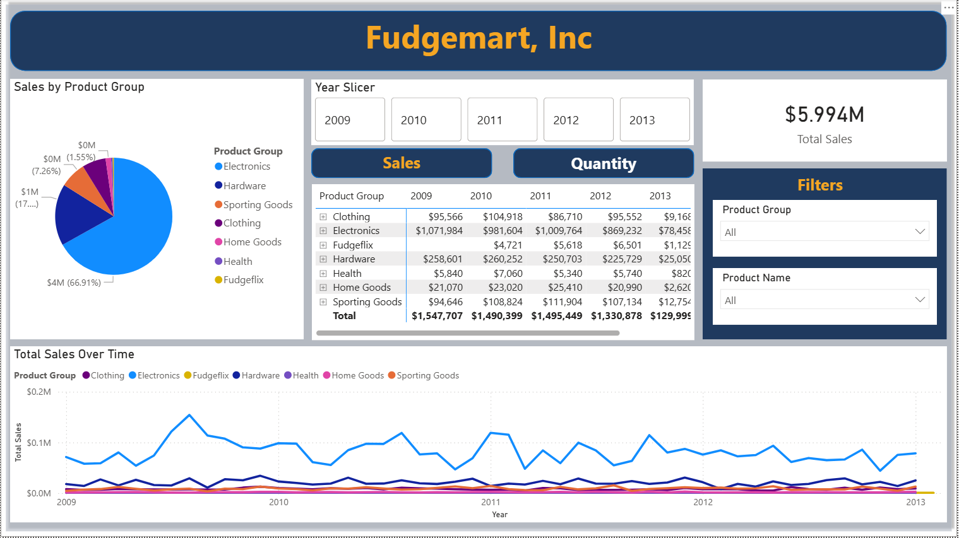
BI Insights / Power BI Story
Group 3_FudgeMart Inc Sales

Slide 17
Sales Trends & Analysis
Electronics
Fudgemart Electronics sales account for 66% of overall sales, due largely to TV sales. Expanding that portfolio would continue strong sales.
Fudgeflix
Compared to overall sales, Fudgeflix is only holding a .3% share. Consider options to expand to Fudgemart customers who currently do not use the service, such as discounts.
Year-over-Year Sales
Although minimal, year-over-year sales have been trending downwards.

Slide 18
Recommendations & Next Step
Additional Fact Tables
Fudgeflix rental trends by account type
Top 5 rentals among types
Fudgemart review summaries by product type/category
Fudgeflix payroll
Additional Data Needed
Fudgeflix employee data

Slide 19
THANK YOU

